Slide 1
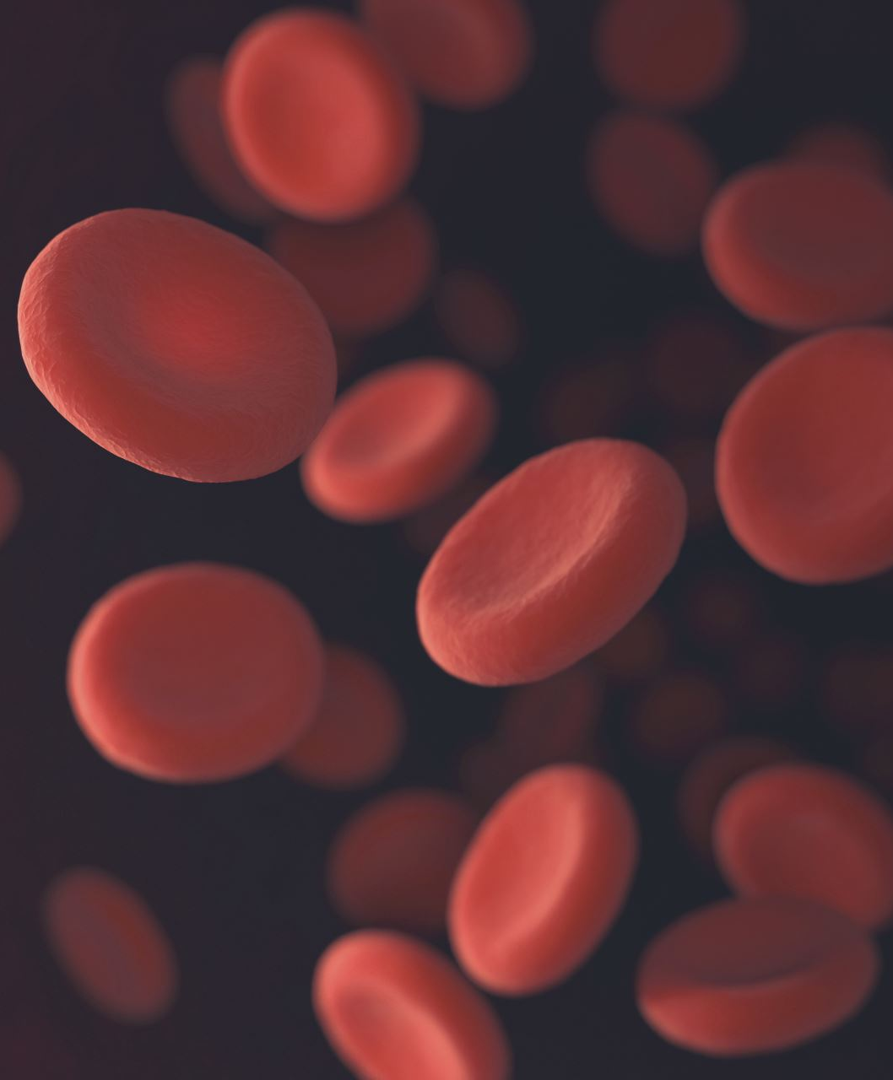
Predictive Blood Glucose Modeling: Understanding Food-Glucose Relationships
Data-Driven Insights for Personalized Nutrition
Team:
Sai Nikhil Vegi
Jagadev Veeranki Ramakrishna Puttagunta
Manas Sai Varma Vatsavai

Slide 2
Project Overview
Problem Statement:
Understand how food affects blood glucose.
Predict glucose spikes and prevent them.

Slide 3
Key Objectives:
Synchronize glucose and food data to align meal timestamps with glucose reading for accurate analysis.
1
Identify type of foods: Red food or food combination(>140mg/dl) cause spikes, green food prevent or minimizes the spikes.
2
Train a model to predict the glucose spikes on meal data.
3

Slide 4
Expected Outcomes
Food Classification
A clear categorization of "red" and "green" foods for participants.
Data-backed insights into high-risk and low-risk dietary choices.
Predictive Accuracy
A robust glucose prediction model validated on real-world data.
Improved accuracy in predicting glucose responses post-meal.

Slide 5
Project Significance
Proactive Glucose Management: Prevents spikes through personalized dietary insights.
Improved Interventions: Optimizes the timing of medications and lifestyle changes for better outcomes.
Preventive Medicine: Reduces risks of complications by enabling early intervention.
Personalized Care: Supports tailored care plans for high-risk individuals, enhancing overall treatment efficiency.

Slide 6
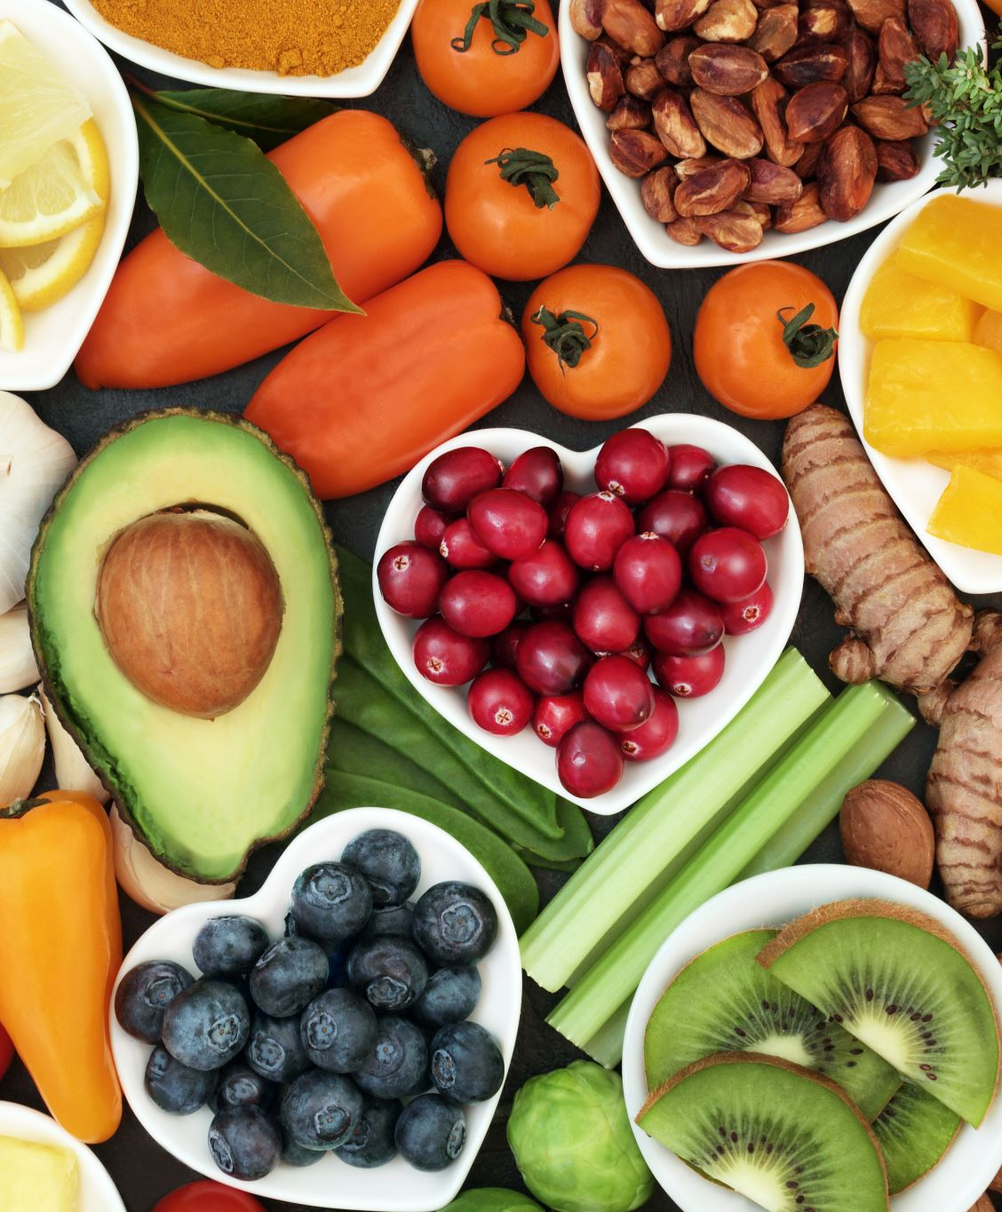
Project Significance
Personal Health Benefits
Enhanced Glucose Control: Individuals gain actionable insights to make better food choices.
Improved Quality of Life: Reduces the risk of long-term complications, enabling healthier living.
Empowerment Through Data: Personalized recommendations help individuals feel more in control of their health.
Research Value
Advancing Analysis Techniques: Introduces new methods for studying food-glucose relationships.
Machine Learning in Medicine: Leverages predictive models to identify trends and provide actionable outcomes.
Notes:
Individuals gain actionable insights to make better food choices.

Slide 7
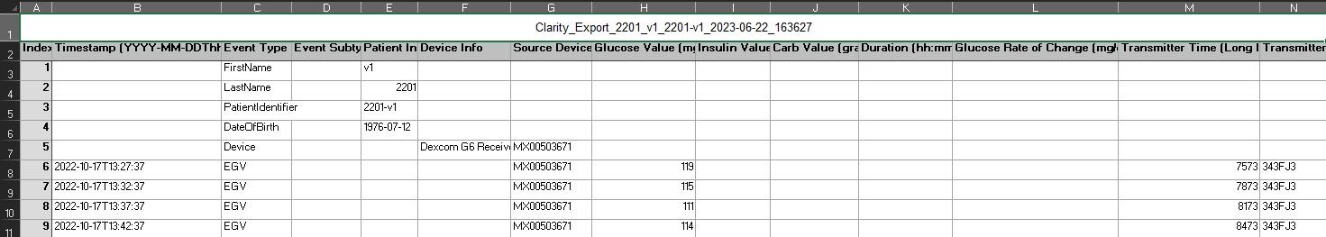
Data Source
Continuous Glucose Monitoring (CGM)
Data Sample size: 30 participants, ~288 readings/day/person.
Duration: 2–4 weeks per participant.
Format: Excel with timestamped glucose readings.

Slide 8
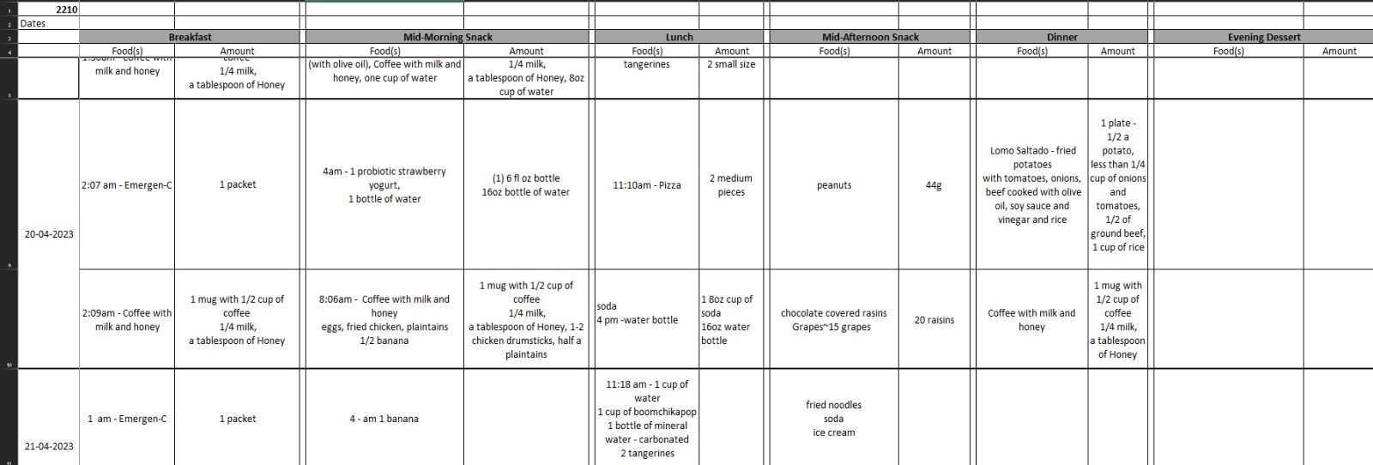
Food Diary Data
Detailed records of meals, portion sizes, and ingredients.
Format: Excel and Word files with meal timestamps.

Slide 9

Technical Architecture
Development Environment
Python 3.8+ with Google Colab integration.
Git for version control.
Core Libraries
Pandas, numpy: Data handling and processing.
Scikit-learn: Machine learning algorithms.
Matplotlib, seaborn: Visualization.
Openpyxl, python-docx: File handling.
Additional Features
Logging for debugging and tracking errors.
Datetime for time-series synchronization.

Slide 10

Data Processing Pipeline
Data Collection
File validation and automated error detection.
Cleaning and Preparation
Handling missing values, outliers, and duplicate entries.
Time zone normalization.
Feature Extraction
Calculating glucose metrics (e.g., spike frequency, peak intensity).
Identifying pre- and post-meal glucose trends.
Spike Detection
Threshold: Glucose above 140 mg/dL for more than 15 minutes.
Categorized spikes into mild, moderate, and severe.

Slide 11
Key Challenges & Solutions
Challenges
Inconsistent formats between Excel and Word files.
Missing timestamps or incomplete food entries.
Detecting overlapping meal and glucose patterns.
Solutions
Implemented format-specific parsers for diverse file types.
Advanced missing data imputation techniques.
Automated spike detection algorithm for accurate timing.

Slide 12
Analysis Methodology
Spike Detection Algorithm
Threshold for a spike: Glucose > 140 mg/dL sustained for ≥15 minutes.
Post-meal analysis window: Up to 120 minutes.
Food-Glucose Correlation
Pre-meal baseline (-30 minutes) compared to post-meal readings.
Identified high-risk combinations and individual response patterns.
Statistical Analysis
Used ANOVA to detect significant food-glucose relationships.
Measured spike severity and duration across food categories.

Slide 13
Machine Learning Approach
Feature Engineering
Temporal features: Meal timing, day of the week, and fasting duration.
Food features: Macronutrient composition, portion sizes, and combinations.
Model Training
Algorithm: Random Forest and Logistic Regression for binary classification (spike vs. no spike).
Data split: 70% training, 15% validation, 15% testing.
Metrics: Precision, recall, and AUC.

Slide 14
Key Findings
Red Foods (Spike-Causing)
Examples: White bread, sugary drinks, pasta.
Trigger frequent spikes across participants.
Green Foods (Spike-Preventing)
Examples: Leafy greens, nuts, lentils.
Consistently associated with stable glucose levels.
Patterns
Breakfast meals had higher spikes than dinner.
Mixed meals had more complex responses, requiring advanced models.

Slide 15

Individual Variations
Response Patterns
Morning vs. evening glucose sensitivity.
Participants with lower variability had fewer spikes overall.
Activity Influence
Pre-meal exercise reduced spikes in 40% of participants.

Slide 16

Real-World Applications
Personalized Recommendations
Tailored meal plans to avoid red foods and incorporate green foods.
Healthcare Integration
Alerts for caregivers and integration with existing medical dashboards.

Slide 17
Technical Innovations
Data Handling
Robust file parsing across different formats.
Novel Spike Detection Algorithm
Dynamically adjusts for individual baselines.

Slide 18
Future Enhancements
Mobile Integration
Real-time notifications for meal choices.
Advanced Modeling
Deploying neural networks for enhanced accuracy.

Slide 19
Conclusion
Achievements: Identified high-risk foods and patterns.
Next Steps: Broader deployment and further testing.

Slide 20

Q&A

